Slide 1
Developing Integration Solutions using Microsoft BizTalk Server 2013
Introduction to BizTalk Server 2013

Slide 2
Course Outline
Module 1: Introduction to BizTalk Server
Lesson 1: Core Architecture and Infrastructure
Lesson 2: BizTalk Server Development
Lesson 3: BizTalk Server Administration
Module 2: Schemas
Module 3: Maps
Module 4: Testing and Deploying Projects
Module 5: Pipelines
Module 6: Routing
Module 7: Adapters
Module 8: Web Services and WCF
Module 9: Introduction to Orchestrations
Module 10: Applied Orchestration Techniques
Module 11: Business Activity Monitoring
Module 12: Integrating Business Rules
Module 13: Deploying and Managing Applications
Module 14: Windows Azure BizTalk Services

Slide 3
Lesson 1: core architecture and infrastructure
Introduction
Evolution
Editions
Infrastructure Architecture
Artifacts and Components

Slide 4

What is BizTalk?
“Microsoft BizTalk Server is used to simplify and automate the exchange of information between publishers and subscribers, to orchestrate business processes and to supply insight into processes”
Integration Server

Slide 5
Why BizTalk?
“We use WCF, WF and ASMX, together with other integration products and technologies from Microsoft, can’t we solve this without BizTalk?”
“Yes, but…”
Notes:
Utbyte av information mellan system

Slide 6











What major pain points does BizTalk solve?
Need to Integrate systems
Inconsistent information from disparate sources
Lack of competency and standards
Want to Automate processes
Inefficient manual processes
Time consuming and focus disturbing
Want insight in information flow
Lack of asset and process visibility
Missing control and re-usability
ERP
HR
E-Commerce
CRM

Slide 7

What major pain points does BizTalk solve?
Must Simplify change
Overwhelmed by frequent business changes
Find it hard to manage business rules and processes
Time consuming development, deployment and management
Need to empower developers to be productive
Many hours spent on building effective plumbing
Even if using plumbing enhanced frameworks like WCF

Slide 8
So… Why wouldn’t you want this (and more) out of the box?
Load Balancing
Availability Monitoring
Identity & Impersonation
Thread Management
Multi-environment Deployment Model
Message Tracking
Failed Message Management
Configuration Management
Scale-out Configuration
Disaster Recovery
Regulatory Compliance
Composite State Management
Fail-over
Health Monitoring
Scripting & Programmability APIs
Memory Management
Service Isolation
Utilization/Performance Tracking
Archiving & Purging
Exception Configuration
Throttling

Slide 9

What functions do you need in Integration?

Slide 10
What areas does BizTalk operate in?
ESB
BAM
SOA
B2B (EDI/AS2)
EAI
Rules Engine
Brooker
BPM
Integration Server
RFID
Message Oriented Middelware
Workflow Engine
Publish/ Subscribe

Slide 11
Evolution
Evolution of Versions
Evolution of Features
BizTalk Server 2000, 2002
BizTalk Server 2004, 2006, 2006 R2
BizTalk Server 2009
BizTalk Server 2010
BizTalk Server vNext
2004, core engine
2006, 2005, Applications, perf.
2006 R2, EDI, RFID, WCF, Adapters
2009, 2008, ESB, EDI, Adapters, ALM
2010, 2010, Mgmt, ESB, Adapters, productivity, B2B,
AppFabric & WF

Slide 12
BizTalk Server 2010
VS.NET 2010
WF 4.0 integration
Windows/SQL 2008 R2
SQL Server 2008 R2
RFID
Settings Dashboard
Admin Console
Low latency
64-bit in Standard SKU
Platform
Performance
B2B
Productivity
TPM improvements
FTPS Adapter
Protocol updates
Improved Mapper
SCOM re-write
(Powershell? No?)
ExplorerOM x64 support

Slide 13
BizTalk Server 2010
Visual Studio 2010 and .NET 4.0 support
New and Improved Mapper
WF 4.0 Integration
RFID components
ExplorerOM 64-bit
Developer / Productivity
Windows Server 2008R2
SQL Server 2008R2
New and Improved SCOM MP
Live Update & Upgrade option from two previous versions
Improved Admin Console and Settings Dashboard
Backup compression and transparent data encryption
IT-Pro / Manageability
New and Improved Trading Partner Management
Secure FTP Adapter
Updated Adapters with support for new versions and settings
Updated Accelerators
Host Adapter updates
Business / Connectivity

Slide 14
BizTalk Server 2013
VS.NET 2012
.NET 4.5
Windows/SQL 2012
SQL Server 2012
Windows Azure
ESB Toolkit integration.
Integration with cloud services.
PaaS.
Platform
ESB,SOA
B2B
Productivity
Adapters:
RESTful Services
Azure Service bus
SFTP
Enhanced Sharepoint
Improved Dynamic send ports
Dependency tracking
Improved mapping perf with XSLT Compiled Transform.
Notes:
Ersätt med Tetris

Slide 15
BizTalk Server 2013
Visual Studio 2012 and .NET 4.5 support
New and Improved Mapper (for BizTalk Services)
Developer / Productivity
Windows Server 2012
SQL Server 2012
Windows Azure
IT-Pro / Manageability
SFTP Adapter
Updated Adapters with support for new versions and settings
Updated standards support
Business / Connectivity

Slide 16



BizTalk Server 2013
Platform Support
New Platforms and Infrastructure
Windows Server 8
SQL Server 2012 (“Denali”)
Continued support for Windows Server 2008 R2, SQL Server 2008 R2
Increased Developer and IT Productivity
Visual Studio 11 and Windows 8 to develop solutions
In-place migration from BizTalk Server 2010
Extended Platform Integration
DB2 client connectivity to SQL Server, conversion of commands to T-SQL, migration of packages to stored procedures
Adapter connectivity to new data sources, including IBM Informix V11 and IBM IMS/DB V11
Improved B2B
Agile Response to Industry Standards
Regular updates to schemas, accelerators certifications and adapters. Highlights include:
Healthcare: HIPPA 5010 extensions: 2777CA, 999, HL7 2.5.1
Finance: SWIFT SRG 2011 support, SWIFT SRG 2012, SWIFTNet 7.0 (new messaging platform)
Improved Performance and Scalability
HL7 MLLP adapter performance improvements
Better performance with ordered send ports
Enhanced scale out configuration with multiple hosts
Expanded adapter options for faster batch processing
Ready for the Cloud
BizTalk Server on Windows Azure
Enable running BizTalk Server on a Windows Azure virtual machine
Enjoy the benefits of IaaS scale and elasticity
Leverage Windows Azure services, such as Service Bus
Extend on-premises solution to the cloud
Easily extend your on-premises BizTalk Server solution to the cloud in a secure manner
Tighter integration of on-premises BizTalk Server applications with Windows Azure Service Bus
Improved Licensing
Adjustments to licensing that are geared towards cloud hosting, including:
Purchase from a hoster on a monthly basis (SPLA)
Register your existing license with a hoster (License Mobility)

Slide 17
Editions
Developer
Fully featured
Limited in license to design, development and testing
Branch
Limited hub and spoke edition
8 core limit
Single server
One Application
Requires Enterprise
Standard
Fully featured
8 core limit
Single server
Five Applications
Limited virtualization options
Enterprise
High availability/failover
Scale out/failover
Unlimited processing
Unlimited virtualization
Unlimited Applications

Slide 18





IWT
HIS
FlatFiles
Throttling
Monitoring
SSO
Adapters &
Adapter SDK
Business Rules
Engine
Enterprise Service Bus
Adapters &
Adapter SDK
Trading
Partner
Management
EDI/B2B
Process Engine
Pipeline
Pipeline
RFID
Business
Activity
Monitoring
Message
Transform
Accelerators
UDDI
Message
Transform
Pub/Sub Message Engine
Windows & SQL
Notes:
BizTalk by key functions.
Expanded view based on the one used by Tony Meleg in WPC 2011.

Slide 19


What infrastructure components make up BizTalk Servers runtime?
NT-Services
SQL Server
databases
SQL Server Agent jobs

Slide 20

BizTalk Server Concepts
What is it called? | What is it?
BizTalk Group | BizTalk Server central configuration and runtime databases (and the servers that are connected to them).
Server | Physical Server
Host | Logical container for work execution
Host Instance | NTService that executes the work of a Host on a Server
Tips!
You seperate work into Hosts for reasons such as work seperation (Receive, Send, Process, Tracking etc), thread, memory and other resources management, security, processing architecture (32/64 bit), etc.

Slide 21


Hosts and Host instances
BizTalk Group
Logical Hosts
Physical Servers
Host1
BizTalk databases
Server1
Work X
Host1 Instance
Work Y
...
Host2 Instance
Host2
Server2
Work Z
Host1 Instance
Work U
...
Host2 Instance

Slide 22



Basic Highly Available BizTalk Server Infrastructure Configuration
BT
BizTalk Group
Isolated
Host instance
In-process
Host instance
Isolated
Host instance
In-process
Host instance
SQL Server Active/Passive Cluster
Master Secret Service
Master Secret Service
MessageBox database
MessageBox database
Tracking database (DTA)
Tracking database (DTA)
Other BizTalk databases
Other BizTalk databases

Slide 23

Demo
Creating Hosts and Host Instances

Slide 24
BizTalk Server Concepts
What is it called? | What is it?
Adapter | Standardized piece of BizTalk used for all communication with endpoints
Adapter Receive or Send Handler | Connects Adapter, a communication direction and a Host

Slide 25
BizTalk Adapters and Accelerators
TECHNOLOGY
LOB
LEGACY (Host)
ADAPTER PACK
MQ
MSMQ
HTTP
SMTP
File
FTP
SFTP
POP3
SQL
WCF (7 Bindings)
SOAP
SharePoint
PeopleSoft
JD Edwards
OneWorld XE
JD Edwards
Enterprise1
Oracle ODBC
Siebel
TIBCO Rendezvous
TIBCO EMS
SAP
Microsoft Dynamics
Microsoft Commerce Server
Host Applications
IBM mainframe zSeries (CICS and IMS)
Midrange iSeries (AS/400)
IBM DB2
Mainframe DB2 for z/OS
Midrange DB2/400
DB2 Universal Database for open platforms (AIX, Linux, Solaris, and Windows)
Host Files
Websphere MQ
SAP
Oracle DB
Siebel
Oracle EBS
SQL Server
Accelerators
EDI
SWIFT
HIPPA
HL7
RosettaNet

Slide 26
Hosts, Host instances and Handlers
BizTalk Group
Logical Hosts
Physical Servers
Host1
BizTalk databases
Server1
WorkX
Receive FILE
Host1 Instance
WorkY
Receive FTP
...
Host2 Instance
Host2
Server2
WorkX
Send FILE
Host1 Instance
WorkY
Send FTP
...
Host2 Instance

Slide 27
Demo
Allow our Host to run adapters
Creating Adapter Handlers

Slide 28
BizTalk Server Concepts
What is it called? | What is it?
Receive Port | Configuration container for receiving messages into BizTalk Server
Receive Location | Configuration container for receiving messages into BizTalk Server from a specific endpoint
Send Port | Configuration container for sending messages out of BizTalk Server to s specific endpoint
Send Location
Pipeline | Standardized piece of BizTalk meant for stream-based access to the message and context manipulation either after (receive) of before (send) adapter execution

Slide 29
Receive Ports and Receive Locations
Host
Receive Port
Receive Location
Adapter
Pipeline
Map

Slide 30

Send Ports
Host
Host
Receive Port
Send Port
Receive Location
Adapter
Adapter
Pipeline
Pipeline
Map
Map

Slide 31

BizTalk Server Concepts
What is it called? | What is it?
MessageBox | Central Publish/Subscribe database
Publish/Subscribe | Architecture pattern central to BizTalk
Receive Port
Send Port
MsgBox

Slide 32


BizTalk Architecture and Publish/Subscribe
Host
Host
Receive Port
Send Port
Receive Location
Adapter
Adapter
Pipeline
Pipeline
Map
Map
Message Box
Messages
Subscriptions

Slide 33
What pros and cons can you see with the MessageBox approach?

Slide 34

Where are BizTalk Servers infrastructure components installed?

Slide 35
Where are BizTalk Servers infrastructure components installed?

Slide 36
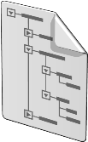
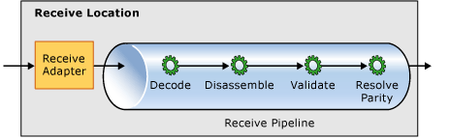
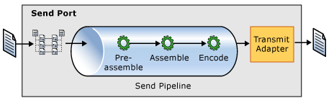
Context based Routing
BTS.ReceivePortName = ”RcvOrder”
RcvOrder
SndOrder
MsgBox

Slide 37
Content based Routing
CustomerType = ”VIP”
SndOrder_VIP
RcvOrder
MsgBox
Order.xml
SndOrder_Default
CustomerType != ”VIP”

Slide 38
Demo
Creating a passthrough messaging integration
Notes:
(Slide 18)
Go to Start – Programs – BizTalk Server 2010
Open BizTalk Server Administration Console
Expand BizTalk Group, then expand Applications
Select BizTalk Application 1
Select Receive Ports, New Receive Port, name it Mod1Receive
Create a Receive Location, name it Mod1Receive_FILE
Select FILE as transport
Note the logical container (host) the work will be performed by (BizTalkServerApplication)
Note the pipeline used (Passthrough)
Note where you would configure a map
(Slide 22)
With BizTalk Server Administration Console open.
Under BizTalk Application 1, select Send Ports, New Send Port
Create a new Send Port
Select FILE as transport
Note the logical container the work will be performed by
Note the pipeline used
Note where you would configure a map
Set the filter as BTS.ReceivePortName = Mod1Receive
Drop in a FILE (any file) and see it pop out the other side.

Slide 39
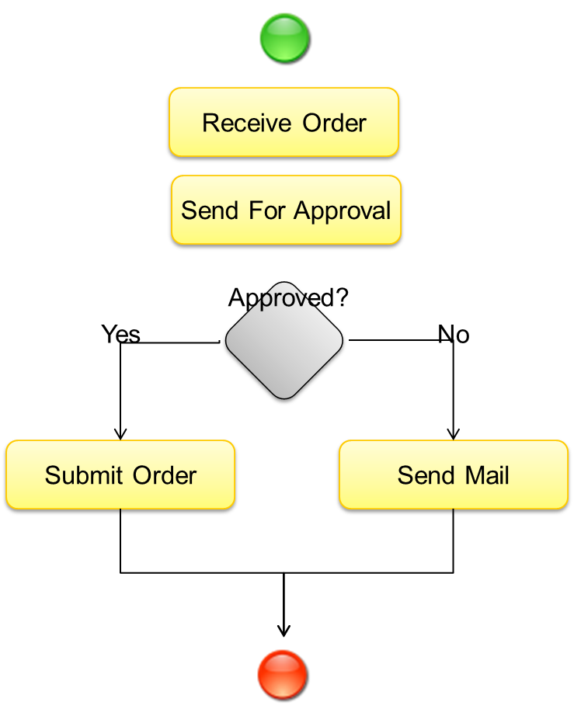
BizTalk Server Concepts
What is it called? | What is it?
Orchestrations | Model driven development and execution unit representing a process

Slide 40

BizTalk Architecture and Publish/Subscribe
Host
Host
Receive Port
Send Port
Receive Location
Adapter
Host
Adapter
Orchestration
Pipeline
Pipeline
Map
Map
Message Box
Messages
Subscriptions

Slide 41

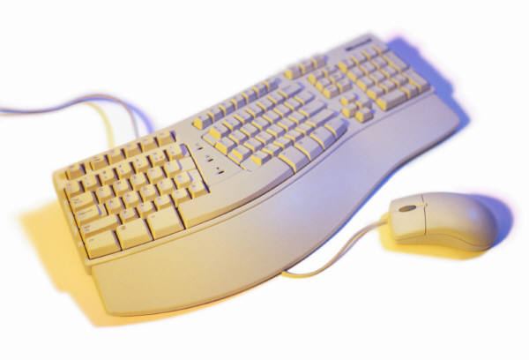
Hands-On-Labs
Configure your first file integration with BizTalk Server
Working with the BizTalk Administration Console
Create a BizTalk Application
Create a Receive Port and Receive Location
Create a Send Port with filters
Send a file
Exercise 1

Slide 42
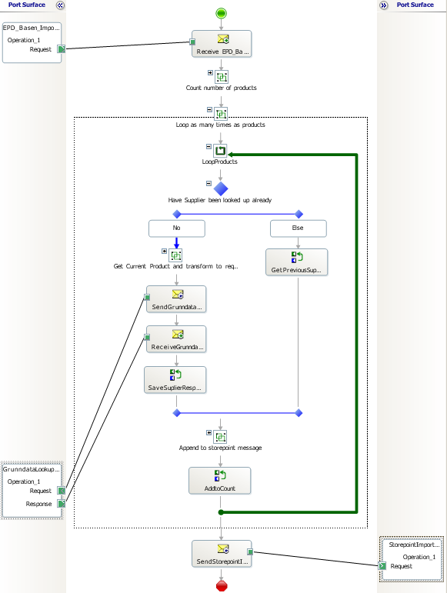

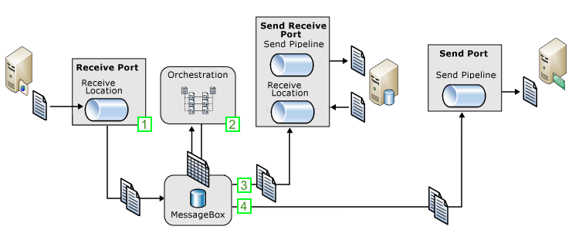
Typical Message flow scenario
Receive order, lookup data, send to subscriber
Receive message through a receive port.
An orchestration subscribes to the message to perform processing and enrichment.
As part of the processing messages are sent to a solicit-response send port (Web service) to lookup data
The message is enriched (mapped), to contain the sum of all parts.
When processing is completed the message is sent to the final recipient through a send port.

Slide 43
Lesson 2: BizTalk Server Development
Project Templates
Schemas and the Schema Editor
Transformations and the Mapper
Pipelines and the Pipeline Designer
Orchestrations and the Orchestration Designer

Slide 44
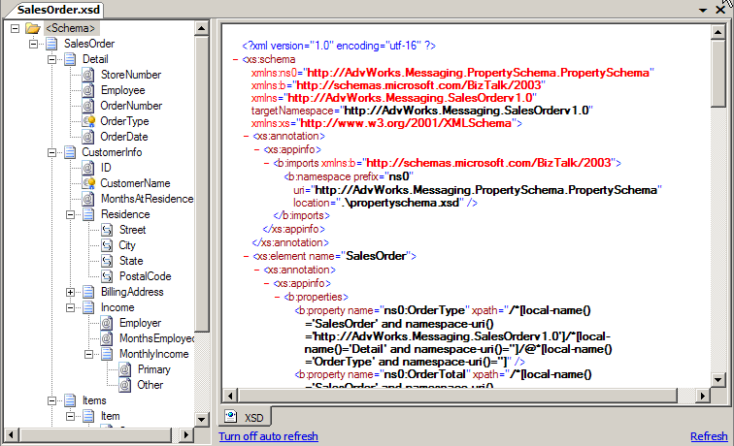
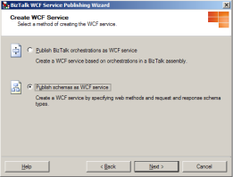
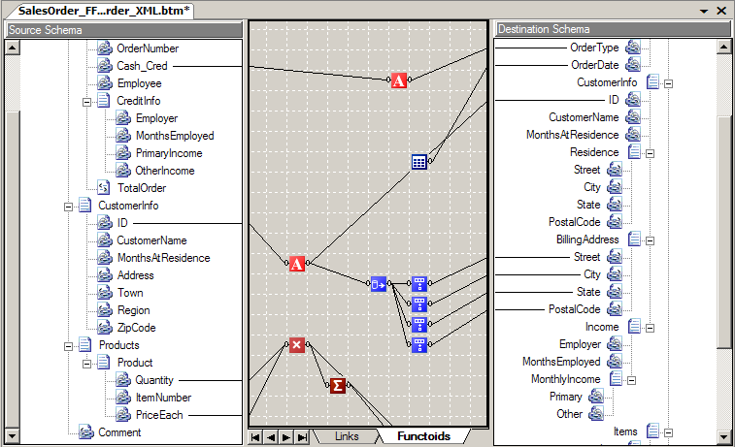


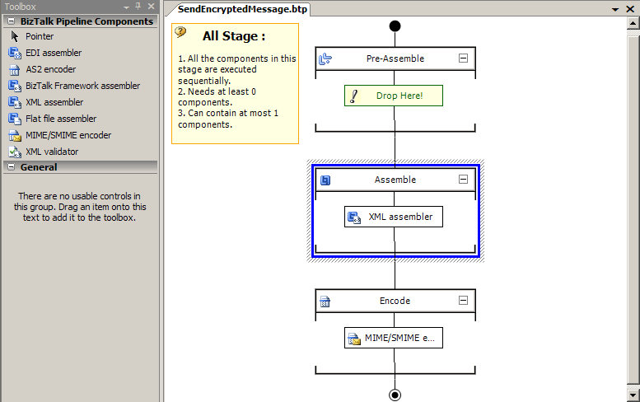
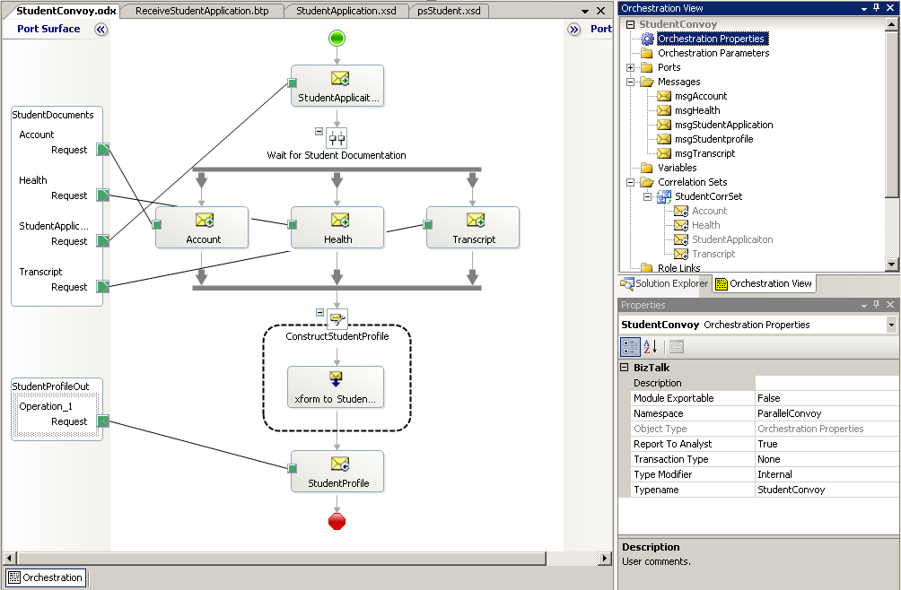
Define Schemas
Rapid development
Transform Data
Wizards
BizTalk Mapper
BizTalk Editor
Design Business Processes
Process Messages
Orchestration Designer
Pipeline Designer
BizTalk Server 2006 – Visual Studio 2005
BizTalk Server 2009 – Visual Studio 2008
BizTalk Server 2010 – Visual Studio 2010
BizTalk Server 2013 – Visual Studio 2012

Slide 45
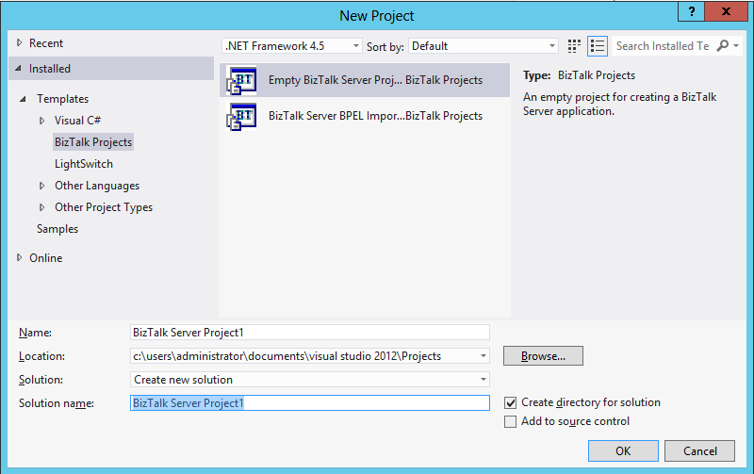

Project Templates
BT
BT
Empty BizTalk Server Project
BizTalk Server BPEL Import

Slide 46
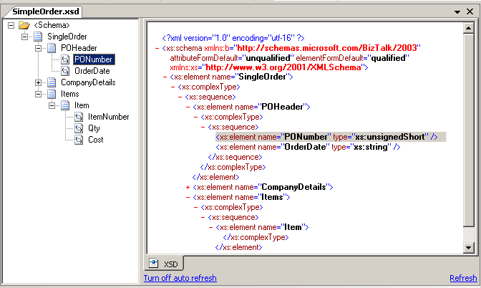
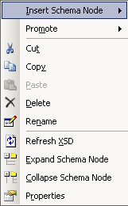
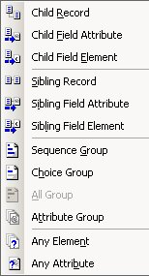
Schemas and the Schema Editor
Schemas represent the message data structure
Data is XML, delimited or positional
Schema Tree View
Editor options
XSD View

Slide 47
Maps and the Mapper
Functoid
BizTalk maps are used for data transformation and translation
They are based on XSLT
Source
Schema
Map Grid
Destination Schema

Slide 48


Pipelines…
Use pipelines to:
Normalize data from various formats to XML
Serialize data from XML to various formats
Assemble and disassemble messages
Decode and encode messages
Decrypt and encrypt messages
Assign and verify digital signatures
Pipeline Components

Slide 49
...and the Pipeline Designer
Stages
Toolbox
Designer Surface

Slide 50
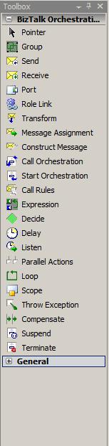
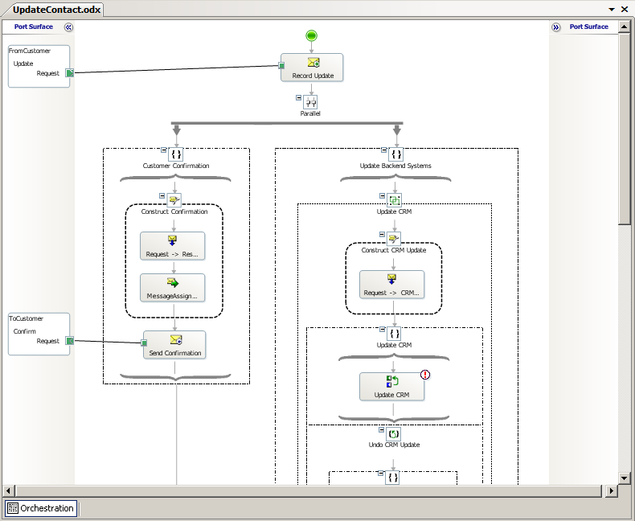
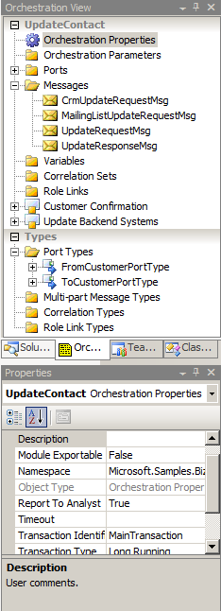
Orchestrations and the Orchestration Designer
Design Surface
Visual Designer
Pre-defined shapes
Drag-drop-configure
Not extensible, but the Expression shape allows you to do basically anything.
Orchestration view
Toolbox
Property Window
Port Surface

Slide 51
Demo
Creating a BizTalk project
Adding artifacts
Notes:
(Slide 36)
Open Visual Studio 2012
Create a new Empty BizTalk Server Project
Add a New Item – Schema – View the designer (very briefly)
Add a New Item – Map – View the mapper (very briefly)
Add a New Item Orchestration – View the designer (very briefly)

Slide 52
Hands-On-Labs
Building your first BizTalk Server solution
Create a BizTalk project in Visual Studio 2010
Create a schema
Create a map
Create an orchestration
Exercise 2-4

Slide 53
IWT
HIS
FlatFiles
Throttling
Monitoring
SSO
Adapters &
Adapter SDK
Business Rules
Engine
Enterprise Service Bus
Adapters &
Adapter SDK
Trading
Partner
Management
EDI/B2B
Process Engine
Pipeline
Pipeline
RFID
Business
Activity
Monitoring
Message
Transform
Accelerators
UDDI
Message
Transform
Pub/Sub Message Engine
Windows & SQL
Notes:
Remember… There is alot more to BizTalk, but the things mentioned so far are the core concepts.
Point out BAM, BRE, EDI, Accelerators, RFID, also mention Windows Azure and Service Bus and Windows Azure BizTalk Services

Slide 54
Lesson 3: BizTalk Server Administration
System requirements
BizTalk Server Administration Console
BizTalk run-time infrastructure

Slide 55
System requirements – BizTalk Server 2010
Minimum hardware requirements
Minimum software requirements
1 GHz Intel Pentium compatible CPU
32-bit
2 GB of RAM
10 GB of available hard disk space
Windows Server 2008 Std SP1
Windows XP SP3
SQL Server 2008 Std SP1
.NET 4.0 & .NET 3.5 SP1
2010
Recommended hardware
Recommended software
1 Quad/Hexa/Octo core processor
64-bit
4 GB or more of RAM
45+15 GB or more available hard disk space
Windows Server 2008 R2 Ent
Windows 7
SQL Server 2008 R2 Std

Slide 56
System requirements – BizTalk Server 2013
Minimum hardware requirements
Minimum software requirements
1 GHz Intel Pentium compatible CPU
32-bit
2 GB of RAM
10 GB of available hard disk space
Windows Server 2008 R2 SP1 Std
Windows 7 SP1
SQL Server 2008 R2 SP1 Std
.NET 4.5
Recommended hardware
Recommended software
1 Quad/Hexa/Octo core processor
64-bit
4 GB or more of RAM
45+15 GB or more available hard disk space
Windows Server 2012 Std
Windows 8
SQL Server 2012 Ent

Slide 57
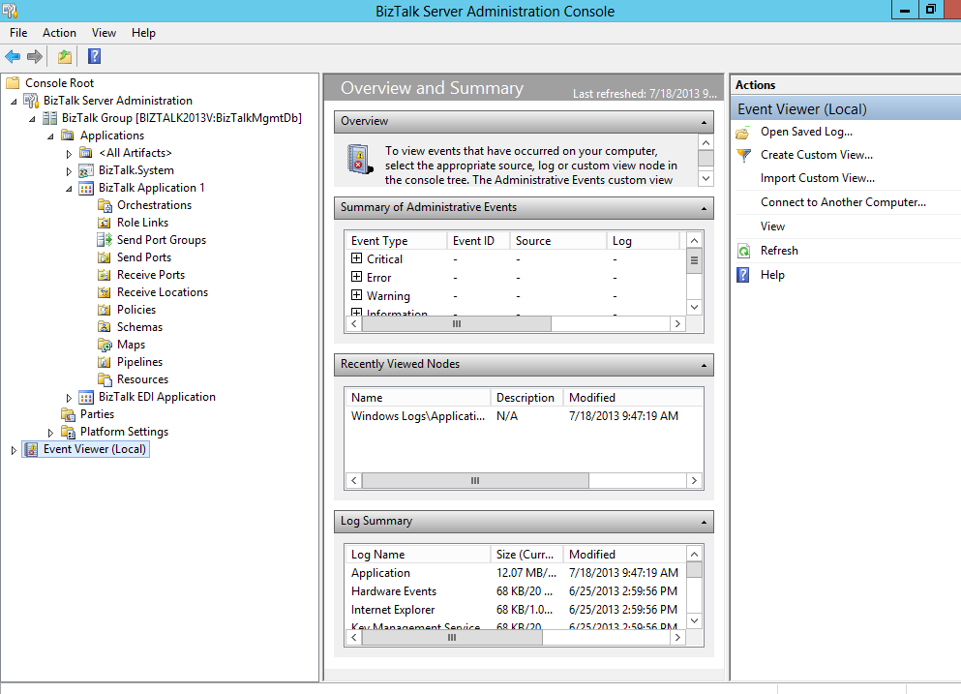
Administration Console
Configuration and Management
Applications
Ports, Adapters, Pipelines
Orchestrations
Start, Stop
Import, Export
Troubleshoot
MMC Console

Slide 58
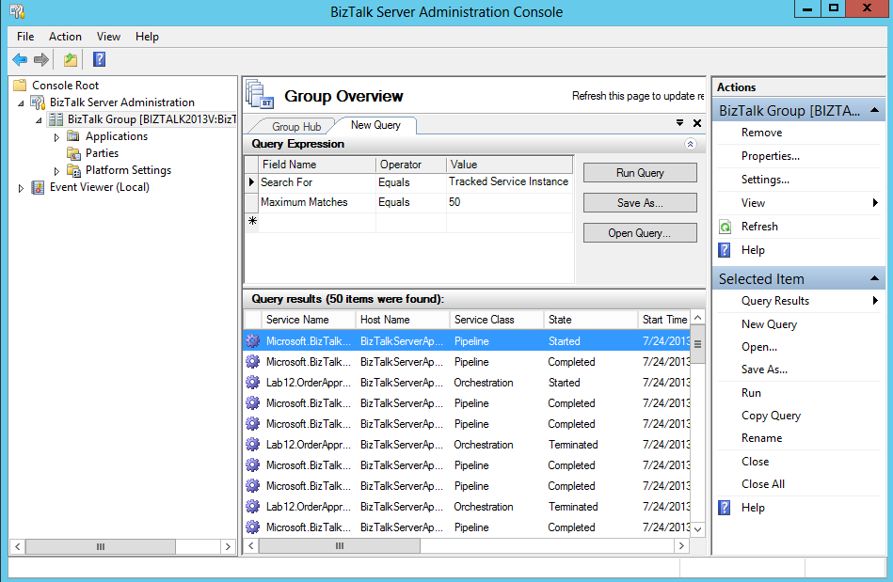
Viewing Tracking Information
Health And Activity Tracking

Slide 59
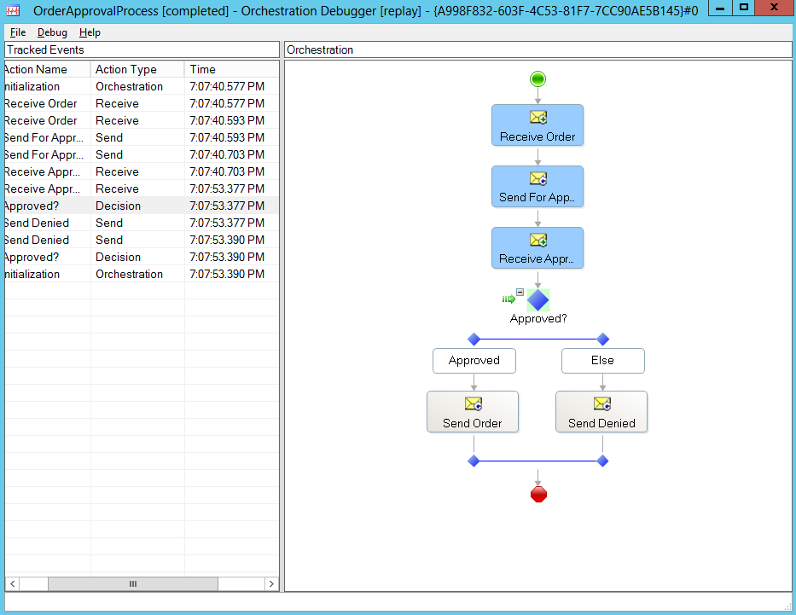
HAT - Orchestration Debugger
Debugging
Monitor orchestration instances and messages
Set breakpoints
Suspend, terminate, or resume processes
View variables and data
Orchestration Debugger

Slide 60
Summary
Microsoft BizTalk Server is used to simplify and automate the exchange of information between publishers and subscribers, to orchestrate business processes and to supply insight into processes.
It builds on a very solid infrastructure.
And has a wide range of tools to support administration and development tasks.

Slide 61
Q & A
Introduction to BizTalk Server 2013

Slide 62
Hands-On-Labs
Deploying and running your solution
Deploy a BizTalk solution and configure it
Create ports to receive and send messages
Test the integration
Exercise 5-6

Slide 63

Quiz
What are some of the scenarios where Microsoft BizTalk Server can be used?
What are some of the tools utilities used within BizTalk Server development and administration?
What would be the appropriate version for a single box production machine?
What is the function of a port?

